Slide 1
Legal Act and IPC Section Prediction System Using Complaint Text Analysis
Team No: 30
Team Members:
Raja Rajeswari R [22IT072]
Nivasshini R [22IT063]
Guide Name:
Mrs.S.Pudumalar

Slide 2
Overview
Introduction
Problem Statement & Descriptions
Literature Review/Existing Solutions
Objectives
Methodologies to solve the problem
Application of Engineering Principles
Social Relevancy & Impact on Environment
Project Timeline/ Individual Contributions
References

Slide 3
Problem Statement & Description
Background:
Due to limited access to legal experts at police stations, law enforcement personnel often lack the knowledge to accurately apply legal sections and acts when drafting FIRs. These errors can result in delayed or flawed investigations, which ultimately impact justice.
Problem:
The main challenge is that police officers, who may not be well-versed in legal details, make mistakes in identifying the right sections or laws to apply in the FIR, leading to incorrect processing of complaints. This can cause legal loopholes that may affect the overall investigation.
Solution:
An API End-Point that can quickly provide the relevant legal information (sections and acts) when officers input the incident details. This app would rely on a large legal database and ensure that each FIR is filed with the appropriate legal foundation, thereby reducing the likelihood of errors and improving the integrity of the investigation.

Slide 4
Literature/Existing Solutions Review
Sl. No | Title | Authors/ Affiliations | Journal Name, Year | _{Observations}
1 | Text similarity algorithms to determine Indian penal code sections for offence report | Ambrish Srivastav, Shaligram Prajapat | International Journal of Artificial Intelligence, Vol. 11, No. 1, March 2022 | Decision Support System (DSS) that uses NLP and text similarity algorithms to identify relevant IPC sections. It employs techniques like TF-IDF, cosine similarity, and word embeddings to enhance accuracy for legal professionals and users.
2 | LegalReasoner:A Multi-Stage Framework for Legal Judgment Prediction via Large Language Models and Knowledge Integration | Xuran Wang,Xinguang Zhang,Vanessa Hoo, ZhouhangShao,Xuguang Zhang | University of Pennsylvania, The University of Texas at Dallas, Georgia Institute of Technology, University of California, San Diego,University of Gloucestershire | Legal Reasoner is a multi-stage framework enhancing legal judgment prediction by integrating large language models with domain- specific knowledge. It improves accuracy by 7.8% through stages of knowledge infusion, case-law retrieval, multi-hop reasoning, and judgment synthesis, providing insights into decision-making processes.
3 | A Survey of Text Similarity Approaches | Wael H. Gomaa,Aly A. Fahmy | International Journal of Computer Applications (0975 – 8887), Volume 68 – No.13, April 2013. | This research introduces a two-staged NLP framework for sentiment assessment in Indian Supreme Court judgments.
4 | JusticeAI: A Large Language Models Inspired Collaborative and Cross-Domain Multimodal System for Automatic Judicial Rulings in Smart Courts | Nagwan Abdel Samee, Maali Alabdulhafith, Syed Muhammad Ahmed Hassan Shah, Atif Rizwan | IEEE Access | This study presents the Cross-Domain Neural Knowledge Fusion (CDKF) system, enhancing judicial decision-making accuracy to 83% by integrating AI methodologies with ECHR data for smart court rulings. DOI: 10.1109/ACCESS.2024.3491775

Slide 5
Literature/Existing Solutions Review
Sl. No | Title | Authors/ Affiliations | Journal Name, Year | Observations
5 | A Novel Method of Indian Penal Code Section Classification for Offence Incident Report | Ambrish Srivastav, Shaligram Prajapat | IEEE Access | This research proposes a novel corpus for the Indian Penal Code (IPC) to enhance text similarity analysis using various algorithms, aiming to improve classification of offences in legal documents through advanced NLP techniques. DOI: https://doi.org/10.21203/rs.3.rs-2885274/v1
6 | A two-staged NLP-based framework for assessing the sentiments on Indian Supreme Court judgments | Isha Gupta, Indranath Chatterjee, Neha Gupta | International Journal of Information Technology | This study introduces a two-stage NLP model using Latent Dirichlet Allocation and sentiment analysis to assess public sentiment on Indian Supreme Court judgments, enhancing understanding of legal documents. DOI: 10.1007/s41870-023-01273-z
7 | Ipc Chatbot: A Chatbot For Indian Penal Code | Murugesan J, Dinesh M, Kaneshk P M, Narayanasamy R, Susmitha V | International Journal of Creative Research Thoughts (IJCRT) | Information on crimes and penalties under the Indian Penal Code, utilizing a CSV dataset and language support.
8 | Keywords based Closed Domain Question Answering System for Indian Penal Code Sections and Indian Amendment Laws | Rohini P. Kamdi, Avinash J. Agrawal | International Journal of Intelligent Systems Technologies and Applications | Proposes a closed-domain QA system for Indian Penal Code and amendment laws, utilizing keyword-based retrieval to enhance answer precision. The system processes structured and unstructured queries, achieving 94% precision and 82% recall in tests. DOI: 10.5815/ijisa.2015.12.06

Slide 6
Objectives
To develop an API endpoint that efficiently processes complaints or text inputs and accurately returns relevant IPC sections, legal acts, and case laws, thereby enhancing the speed and effectiveness of FIR filing.
To implement bilingual functionality in both Tamil and English, ensuring greater accessibility and ease of use for police personnel across diverse linguistic regions.
To significantly improve the accuracy of the existing model and optimize the system architecture through the integration of machine learning techniques, delivering more precise and reliable legal recommendations.
To enhance legal knowledge accessibility within police stations, particularly in regions with limited legal expertise, by providing access to everyone in requirement of legal assistance on FIR Drafting.

Slide 7
Methodologies
1.Model Development:
i) Use Natural Language Processing (NLP) to allow the model to understand and interpret written inputs related to the complainant's case.
ii) Integrate machine learning algorithms to provide accurate and appropriate suggestions based on the details provided in the FIR.
2.User Interface (UI) and Experience (UX):
i) Design an intuitive and easy-to-use interface for law enforcement personnel with minimal training using the API End Point.
ii) Implement text input options and suit preferences.
3.Testing and Validation:
i) Conduct tests at a police station to assess the software's accuracy and efficiency.
ii) Use feedback from officers to continuously improve the system.

Slide 8









Application of Engineering Principles
Lower Casing
Tokenization
Stop Word Removal
Lemmatization
Jaccard Similarity
Cosine Similarity
TF-IDF (Term Frequency-Inverse Document Frequency)
Pre Processing:
Text Similarity
Algorithms
Precision
Recall
F1-Score
Word2Vec
BERT
Levelled Searching Algorithm
Word Embedding
Techniques
Performance Evaluation
Metrics

Slide 9
Social Relevancy & Environment Impact
Social Relevancy:
Improved Justice Delivery: The application ensures that FIRs are filed correctly, which helps improve the fairness of investigations and justice outcomes.
Enhanced Training for Officers: With the app, even officers with limited legal expertise can have access to accurate legal knowledge, bridging the knowledge gap.
Transparency: The system ensures that there is a consistent application of legal provisions, reducing the chances of errors due to lack of knowledge or negligence.
Environmental Impact:
SDG 16: Peace, Justice, and Strong Institutions
Your system helps in automating legal complaint classification, ensuring faster legal processing and reducing delays in justice.
It strengthens institutions by making legal access more efficient and transparent for individuals filing complaints.
2. SDG 9: Industry, Innovation, and Infrastructure
.
Enhances digital transformation in legal sectors, making them more efficient
Uses AI and NLP technologies to modernize legal workflows

Slide 10
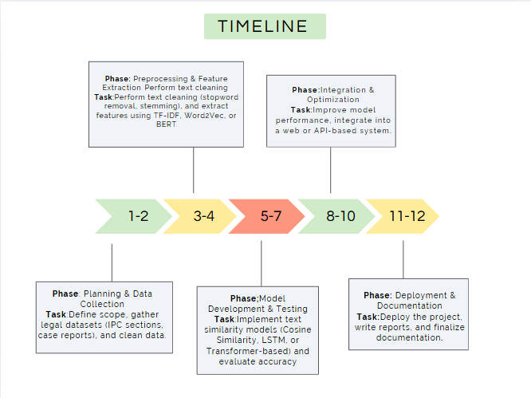
Project Timeline (Sample-GANTT)

Slide 11
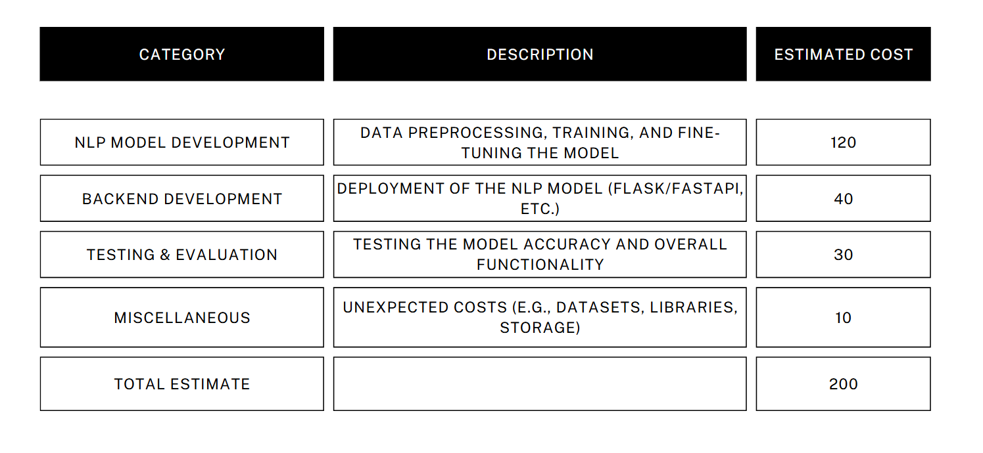
Estimated Cost - Project

Slide 12
References
1.F. Amato, A. Castiglione, G. Cozzolino, and F. Narducci, ‘‘A semantic-based methodology for digital forensics analysis,’’ J. Parallel Distrib.Comput., vol. 138, Apr. 2020.
2.J. Gao, H. Ning, Z. Han, L. Kong, and H. Qi, ‘‘Legal text classification model based on text statistical features and deep semantic features,’’ in Proc. FIRE, 2020
3. Chaojun Xiao, Haoxi Zhong, Zhipeng Guo, Cunchao Tu, Zhiyuan Liu, Maosong Sun, Yansong Feng,
Xianpei Han, Zhen Hu, HengWang, Jianfeng Xu, “ A Large-Scale Legal Dataset for Judgment
Prediction”, CoRR abs/1807.02478 (2018)
4. N. Aletras, D. Tsarapatsanis, D. Preosiuc-Pietro, and V. Lampos,‘‘Predicting judicial decisions of the European court of human rights:A natural language processing perspective,’’ PeerJ Comput. Sci., vol. 2,p. e93, Oct. 2016
5. Nikolaos Aletras, Dimitrios Tsarapatsanis, Daniel Preoţiuc Pietro, and Vasileios Lampos. “Predicting
judicial decisions of the European Court of Human Rights: A natural language processing
perspective”. PeerJ Computer Science 2, 2016,

